Slide 1
Von neumann entropy and central charge : Applied to critical phenomenon of 1D Bose-Hubbard

Slide 2
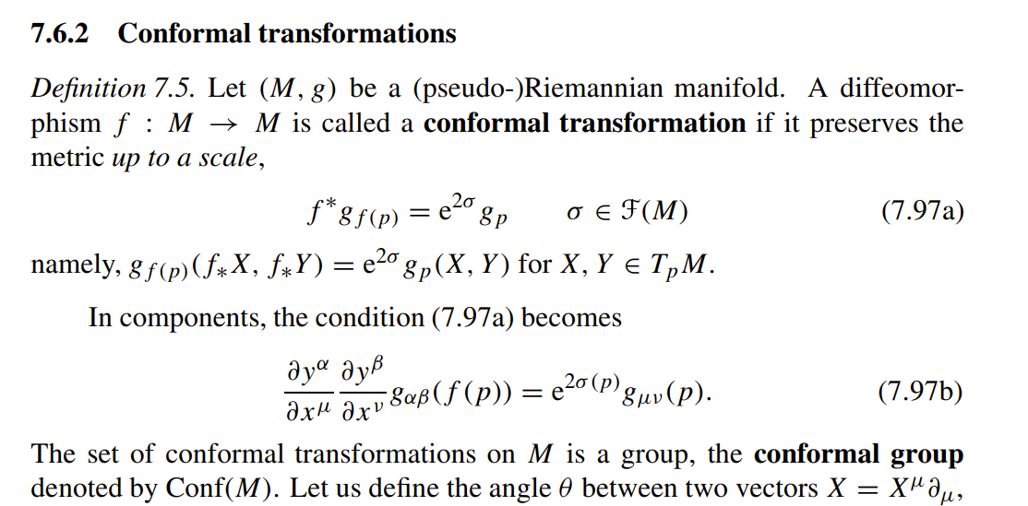
Critical phenomenon and CFT
Why care? [Ref the BPZ paper which introduced idea of 2d cft]
At critical points (where the phase transition occurs) the correlation length diverges and becomes infinity. Why? Because physically then only are all the constituents of system are correlated and the change of phase occurs henceforth. This implies that the scaling becomes symmetric which implies a tracelessness stress-energy tensor in the field theory. The latter condition leads to the field theory being invariant under conformal transformations, a set of mathematical mappings which preserve angles.[Ref nakahara for transformation]

Slide 3
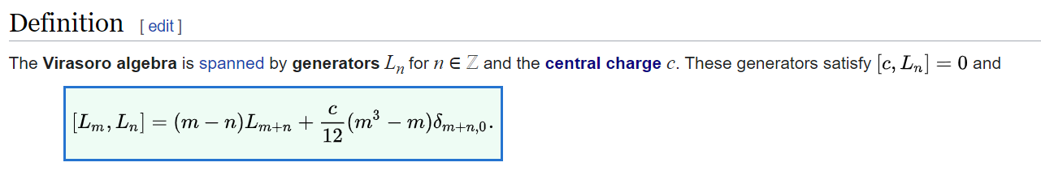

2d CFT and appearance of central charge [BPZ paper]
This is the virasoro algebra, the algebra of generators of conformal group. Here c is the central charge
The components of traceless stress energy tensor represent the generator of conformal group in the qft.
Following Sec 2 of BPZ we see that the commutation relation with some redefinition of the stress energy tensor gives the virasoro algebra where lies the connection between the physics and math.

Slide 4
Continued [ added ref: Zamolodchikov c-theorem paper and personal discussion with prof. Zamolodchikov]
The value of central charge is the parameter of the theory.It is roughly the measure of ‘light’ degree of freedom(degree of freedom of longer range) of a theory. Basically how much degree of freedom does the theory have in large distances.
This picture becomes clearer from the Zamolodchikov c-theorem which states that there is a positive function C(g), where g is a coupling constant in the space of 2d QFTs which monotonically decreases under RG flow(a procedure of integrating out fast degrees of freedom equivalent to increasing scaling or simply how the theory behaves as we increase the scale), this function C(g) is stationary at critical fixed points in theory space which are CFTs(proof in BPZ). The value of c(g*) is at g=g*(fixed point) is same as central charge by proof. So simply there is a function c(g) which keeps on decreasing as the scale keeps increasing until it becomes fixed at points where it is a cft and is equal to central charge. This central charge parameter is now fixed and depends on which fixed point in space of qft it hit(i.e which theory).

Slide 5


Sensitivity to geometry to central charge [Ref: CFT by Di Francesco]
The stress energy tensor over a cylinder is not the same as over a plane. When taken the expectation value of it gives us the zero point energy. We set the zero point energy of a plane vacuum to zero by physical arguments. This yields us
Where L is the radius of the cylinder. This is basically a casimir
energy if thought about carefully and vanishes in limit L->infinity.

Slide 6
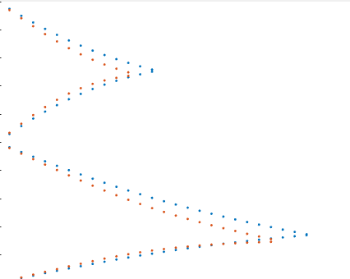
Cont. arguments and application
In (1+1)d CFT, a open lattice moving through time is just a plane worldsheet. While a ring system would for a cylinder worldsheet which would change the associated vacuum point energy (because of presence of central charge) and hence predicts that the critical point in both systems can’t coincide. This is very well captures in the plot we got initially.
So we can see the critical points are not the same in both systems.

Slide 7
Use of central charge to us and what all are we going to calculate
c=½ is a theory of ising field
c=1 gives us Universality class of TL liquid phase (and other theories but we care about just this)
c=15 (for superstring theory)
c=26 (for bosonic string theory, way too much degree of freedom)
So we try to find where does c becomes 1 in our bose-hubbard model, a TL liquid phase from gapped phase where(c<1) as it has less degrees of freedom intuitively from c theorem or we can say it is not a cft and won’t take specific rational values when c<1 (a bound that comes from demanding unitarity of cft).

Slide 8

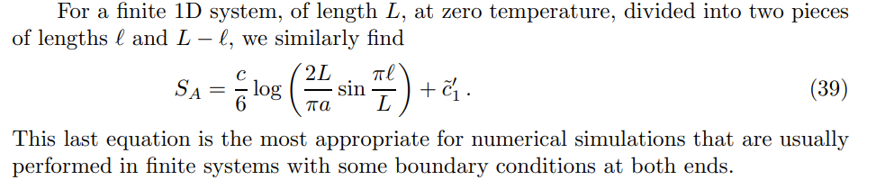
Entanglement entropy and central charge[cardy and calabrese]
In a paper by cardy and calabrese 2004. The calculation of Entanglement entropy in 2D CFT was done. The value of entropy was found to be where pbc is assumed:
As we introduce boundary the entropy changes because of the role of boundary in cft sometimes called bcft.

Slide 9

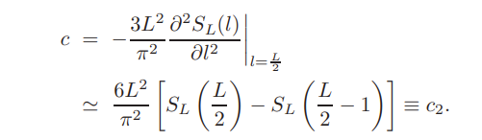
Central charge from Entropy and our implementation[ Satoshi Nishimoto paper]
By algebraic manipulation of the formulas in last page this formula of c is found.
Another alternative is

Slide 10
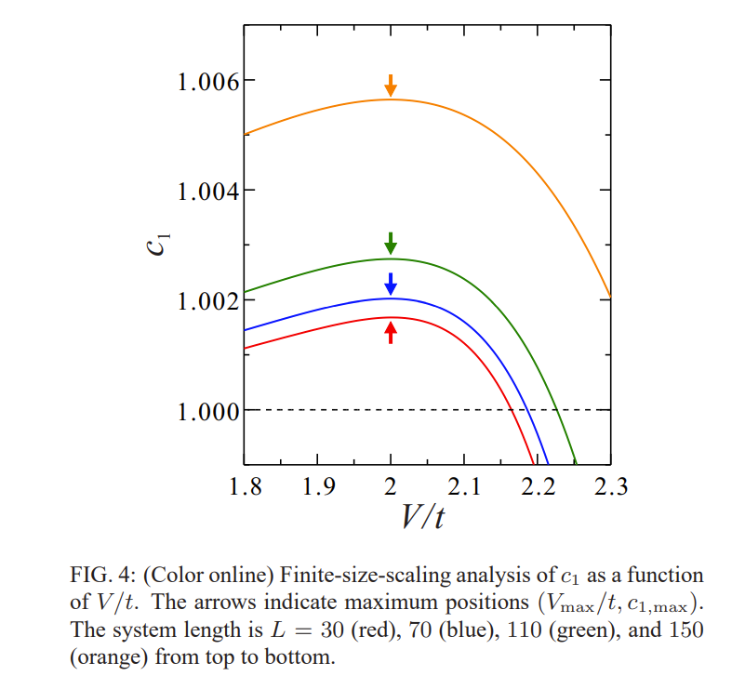
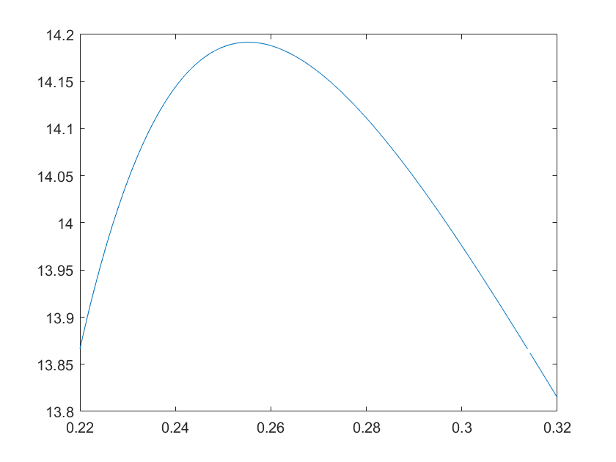
What we do from here?
We use these formulas to compute the central charges at different points t/U (coupling constant). We then graph it to see where does it become maxima to find the critical point. A set of trial runs were done here.
<- To mimic this

Slide 11

Additional analysis for 1D chain in Entropy [Which builds up on cardy paper]
Ref[:Pollman et al]
It makes an observation that that The correlation length scales with respect to bond dimension of Matrix product state (in our case the dimension of largest eigenvalues of DMRG kept) also known as the parameter ‘m’ which we choose.
Putting it in entropy formula yields a simple linear
Relation between entropy and log of bond dimension. The paper goes on to make the strict prediction about kappa too which we calculate using the slope. But this relation only holds at critical points.

Slide 12
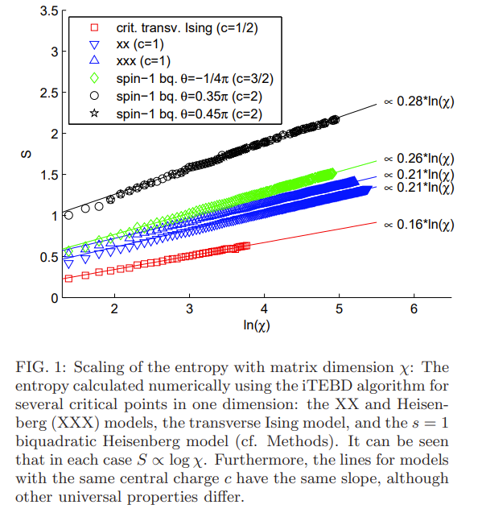
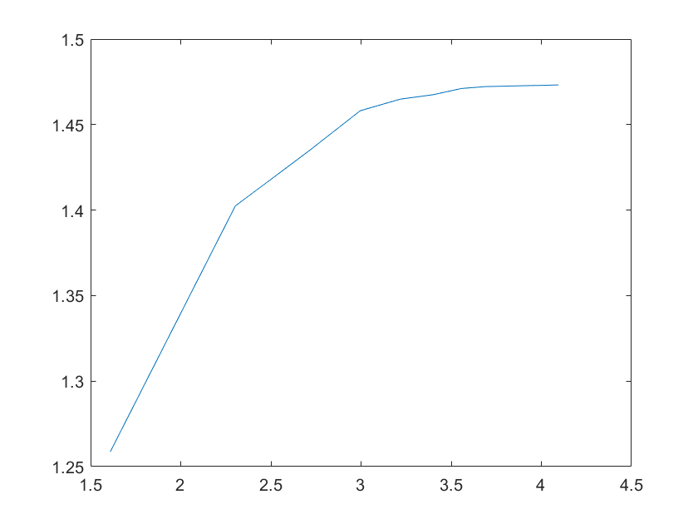
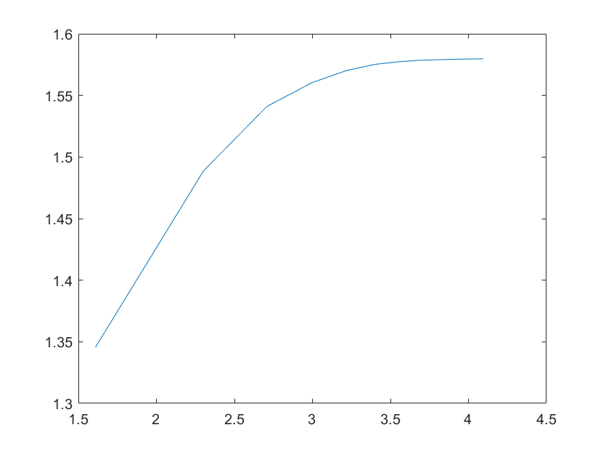
The graph in paper shows the linear relationship
When at critical points(or critical theory).
We can see our entropy saturates but the part to notice is the top one saturates much later than bottom one
Suggesting top one is more near to critical point.

Slide 13
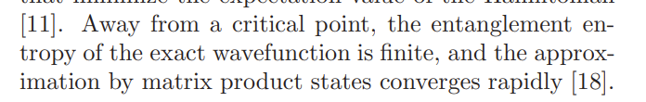
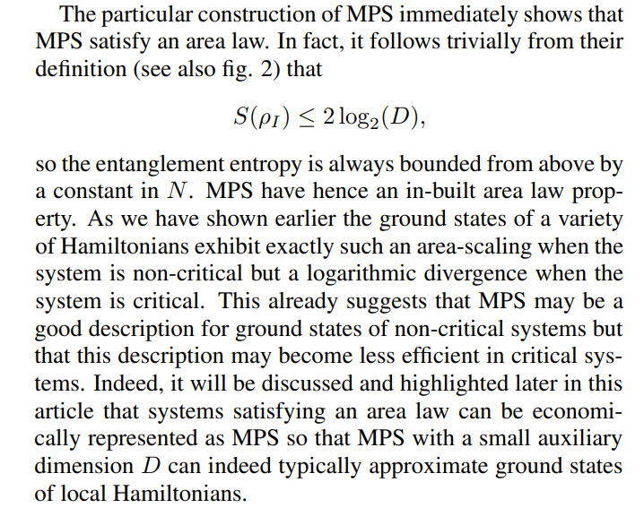
The area law of MPS
This graph seems to bounded because of area law

Slide 14
How is it applied to the 1D Bose Hubbard model?
The 1D Bose hubbard model has a gapped phase (the Mott insulator) and a gapless phase (the superfluid state). Luttinger Liquid is the effective theory for the superfluid state in the Bose hubbard model. It has an established c=1. We are observing for what coupling constant(critical point) does the the central charge go from c<1 to c=1 with some numerical error. Given the known central charge of luttinger liquid we also test the scaling behaviour of Entanglement entropy and the area law in the regime of MPS.

Slide 15
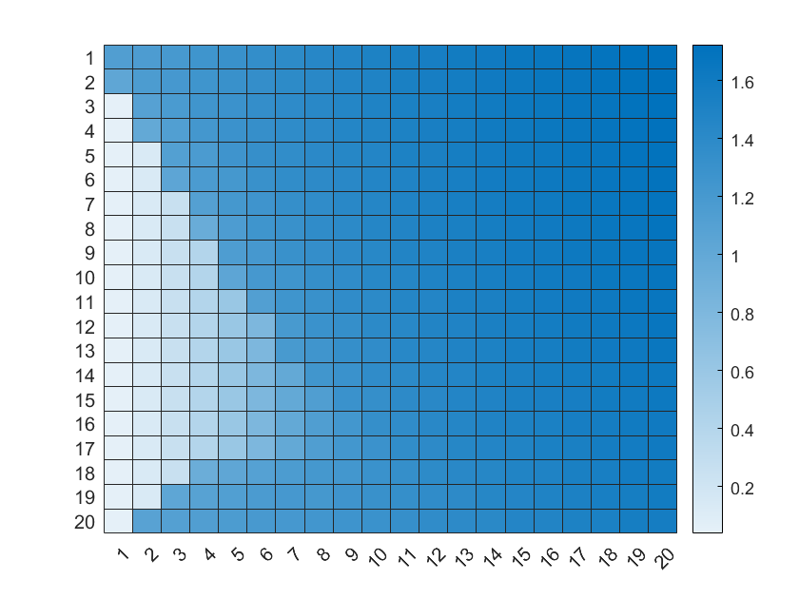
Goal and challenges
We do a heavy numerical analysis of bose hubbard model using these methods which have been successfully implemented in integrable systems. We use them to find quantum critical points. The numerics are on right track as suggested by showing of the mott lobe in 1d by making an entropy heat map. Which very strongly complements the idea behind this analysis.
Challenges are the calculation time. The code
isn’t fast enough even on the cluster and we need
Large chains(for continuum limit and high bond dimension)
as in Nishimoto paper which goes to
central charge as sensitive as 10^-6.

